Slide 1

Movie Recommendation System
Min Gong, Wei Chieh Wang

Slide 2
Agenda
Introduction
Project selection and problem definition
Data collection
Data exploration
Visualization and processing
Dimension reduction and variable selection
Model exploration and selection
Model performance evaluation
Performance visualization
Future work

Slide 3
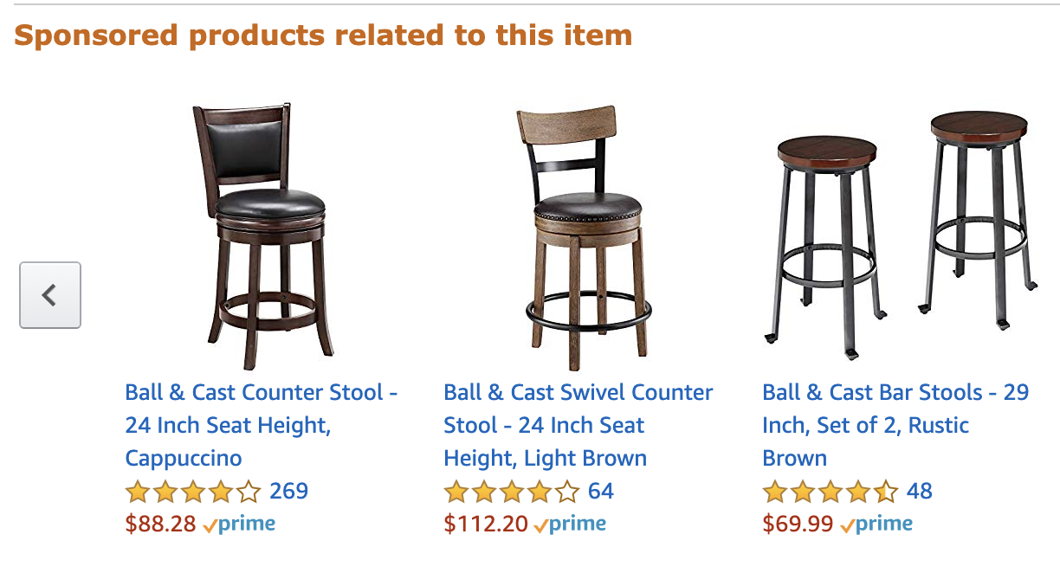
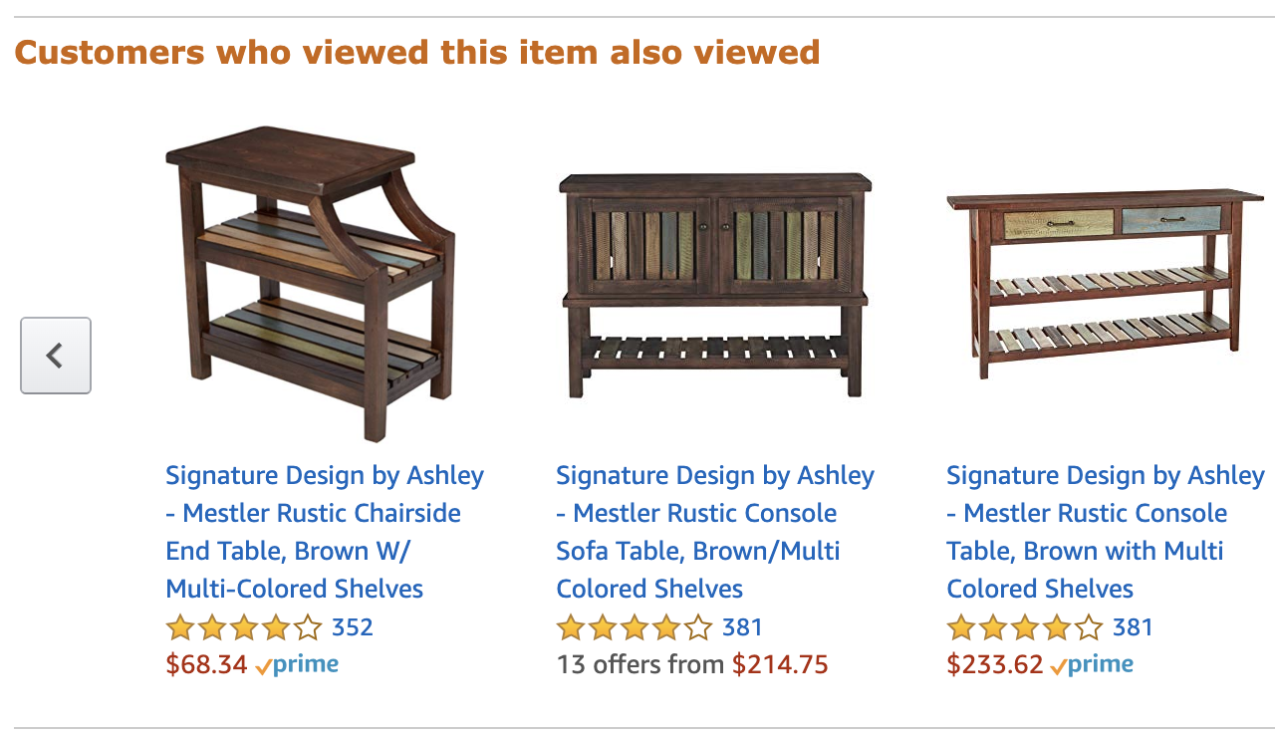
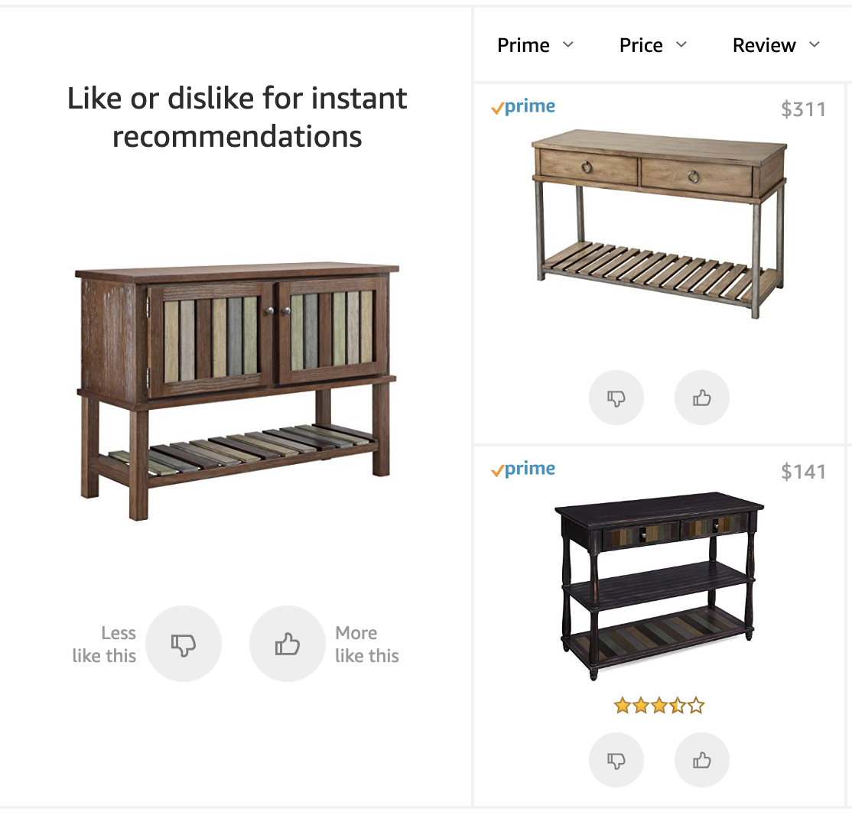
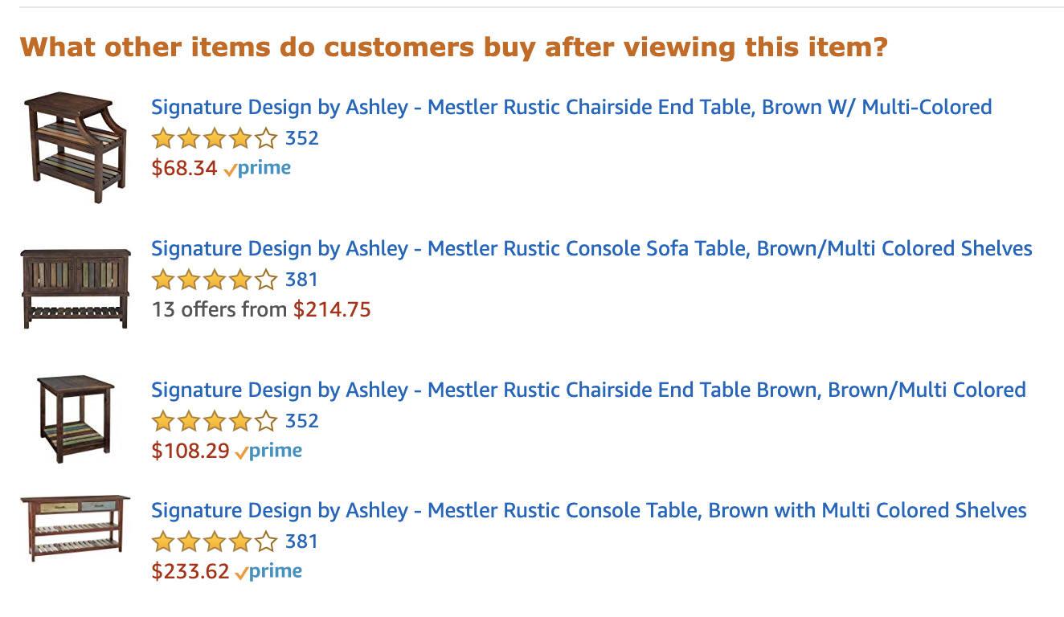
Introduction
Nowadays, auto recommendations are everywhere online in our daily life. Movies, TV programs, music, online shopping and so on.

Slide 4
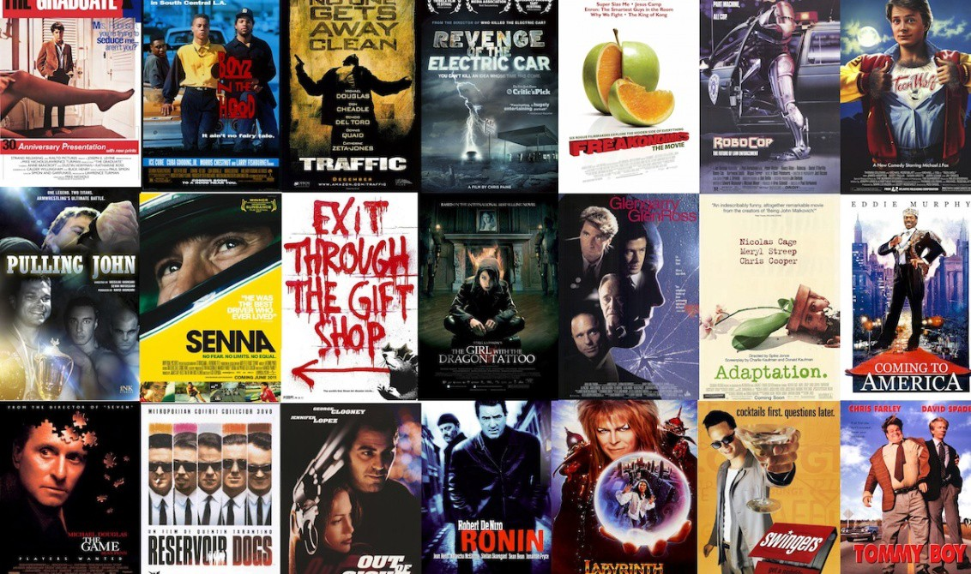
Introduction
How do they know what we like?
We take movies recommendation as an example to figure out this question.

Slide 5
Project selection and problem definition
We chose the movie recommendation system as our data mining project.
By using unsupervised learning methods, we want to analyze each user’s watching and rating history, find patterns and use proper models to recommend potentially liked movies for him/her.

Slide 6
Data collection
Data resource:
https://drive.google.com/file/d/1Dn1BZD3YxgBQJSIjbfNnmCFlDW2jdQGD/view
Data exploration
Our raw data includes two csv files.
movies.csv contains information about movie ID, movie names, released year and genres.
ratings.csv contains information about user ID, movie ID, ratings, and timestamps.
Notes:
W

Slide 7
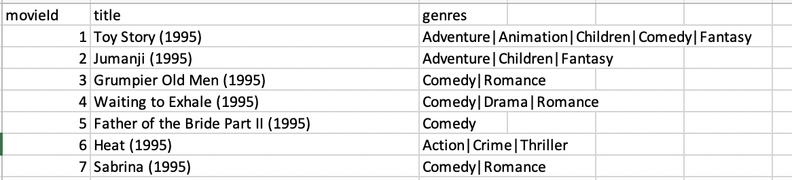
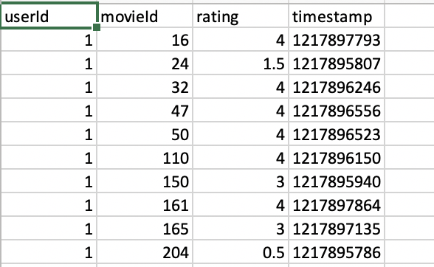
Data exploration
Since the format of raw data in movies.csv is hard to handle in the following data mining process, we transformed it a little bit in excel at first.
Timestamp in ratings.csv is not strongly related to our concerns, so we ignore this variable in the following process.
Notes:
W

Slide 8
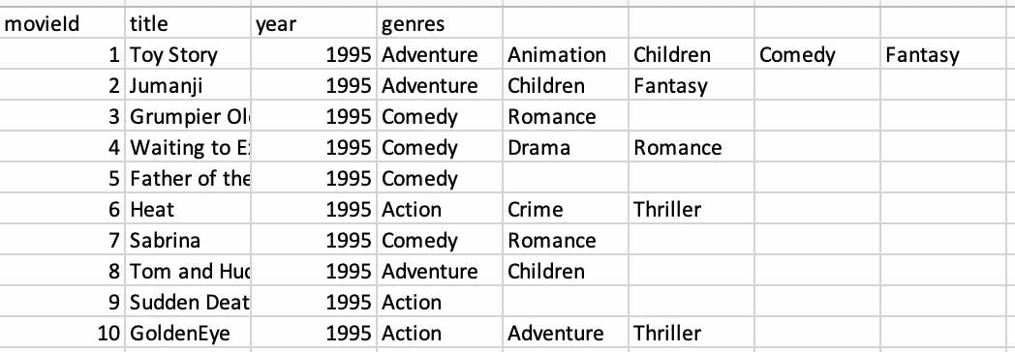
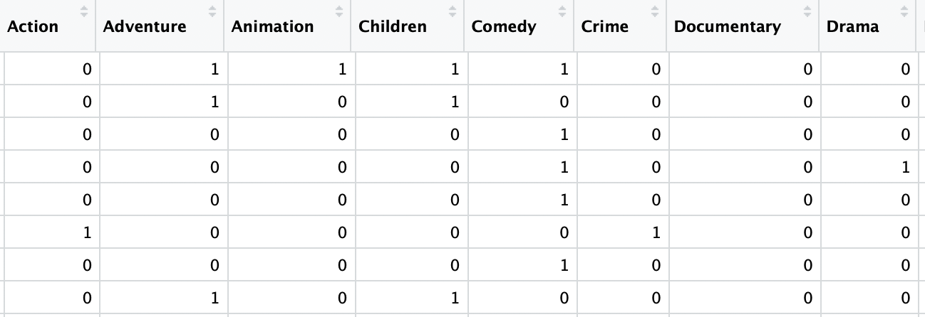
Visualization and processing
Taking some tricks in excel, we convert data in movies.csv to the above format.
In addition, for genres, we convert this categorical data into dummies in R.

Slide 9
Visualization and processing
For movies, we only have two variables to characterize them (excluding ID and names). So, first pop up in our mind, we want to find best movies (based on ratings by users) in each genre or in each time period.
Making and visualizing these top10 rankings could do a help for us to understand the data and could also be a reference for recommendations.
We offer some examples of visualizations here, which include “best movies in 1980s”, “best movies in 1990s”, “best movies in 2000s”, “best action movies”, “best drama movies” and “best Sci-Fi movies”.

Slide 10
Visualization and processing
We take boxplots to visualize the ratings for top10 movies which can not only give average but also variation information for each movie’s ratings.
One thing needs attention here is that, we set a filter for candidates in the rankings in case of a small number of ratings dominates the result. For example, if a movie was just rated by one user, but got a 5, it might get a really high rank which is not convincible. Thus, we only take the movies that received more than 5% number of ratings in the same genre or time period.

Slide 11
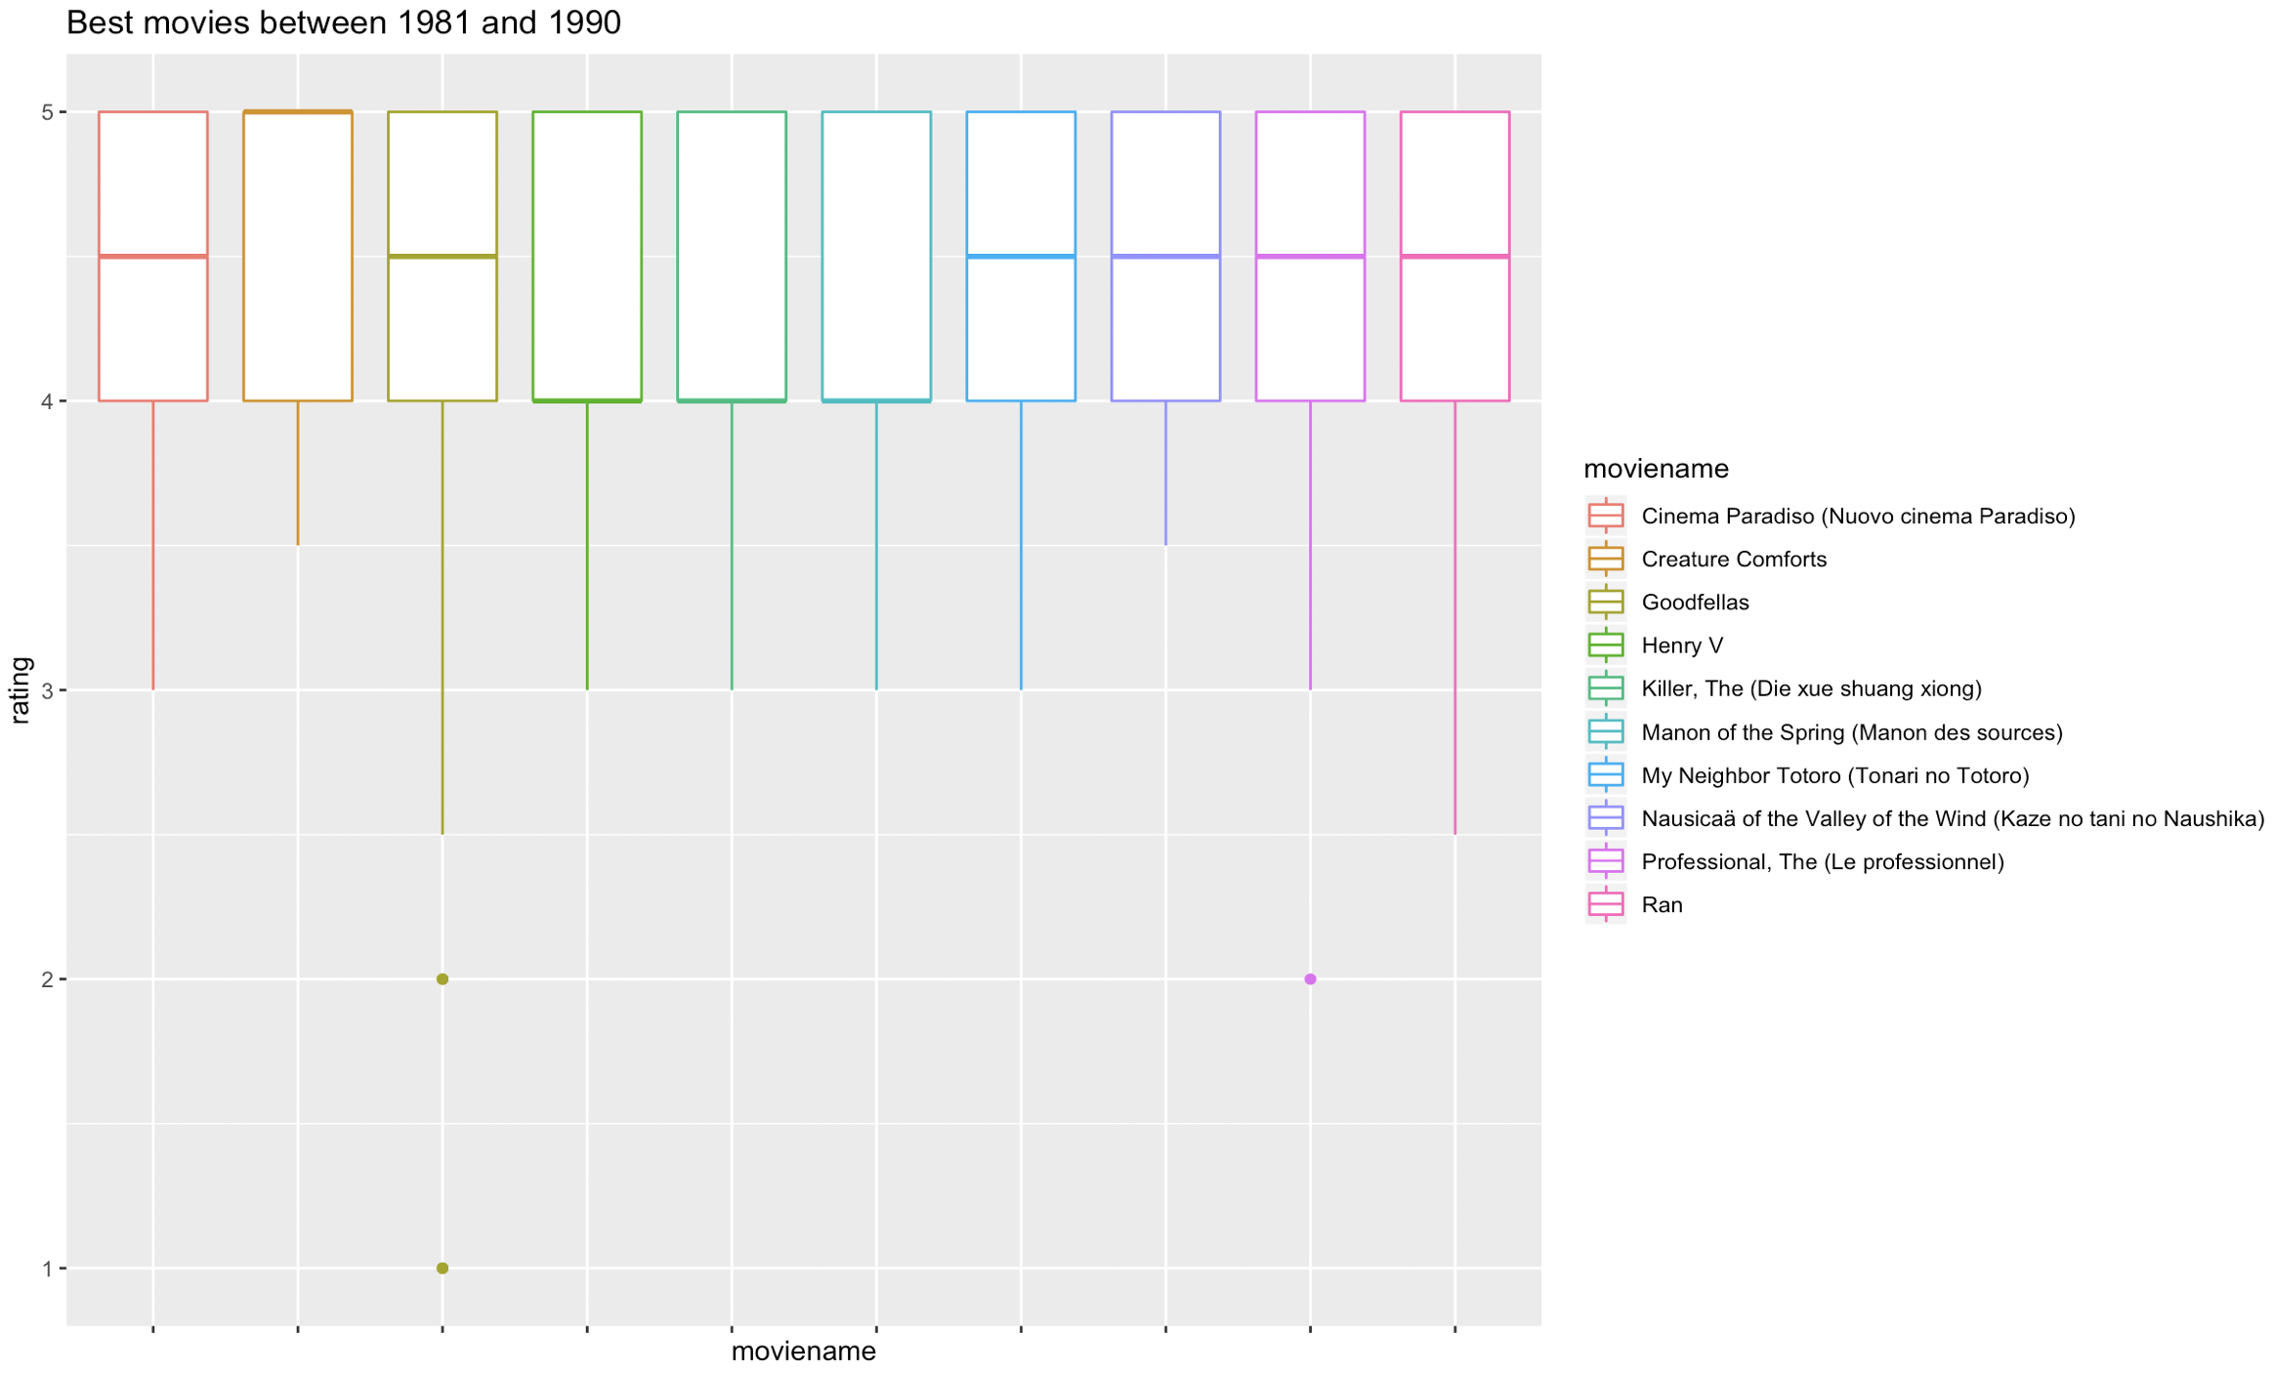
Visualization and processing
best movies in 1980s

Slide 12
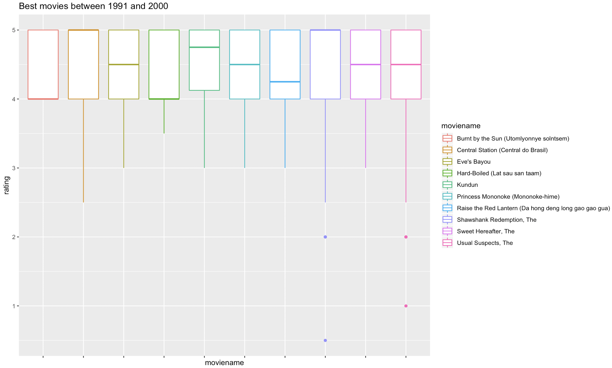
Visualization and processing
best movies in 1990s

Slide 13
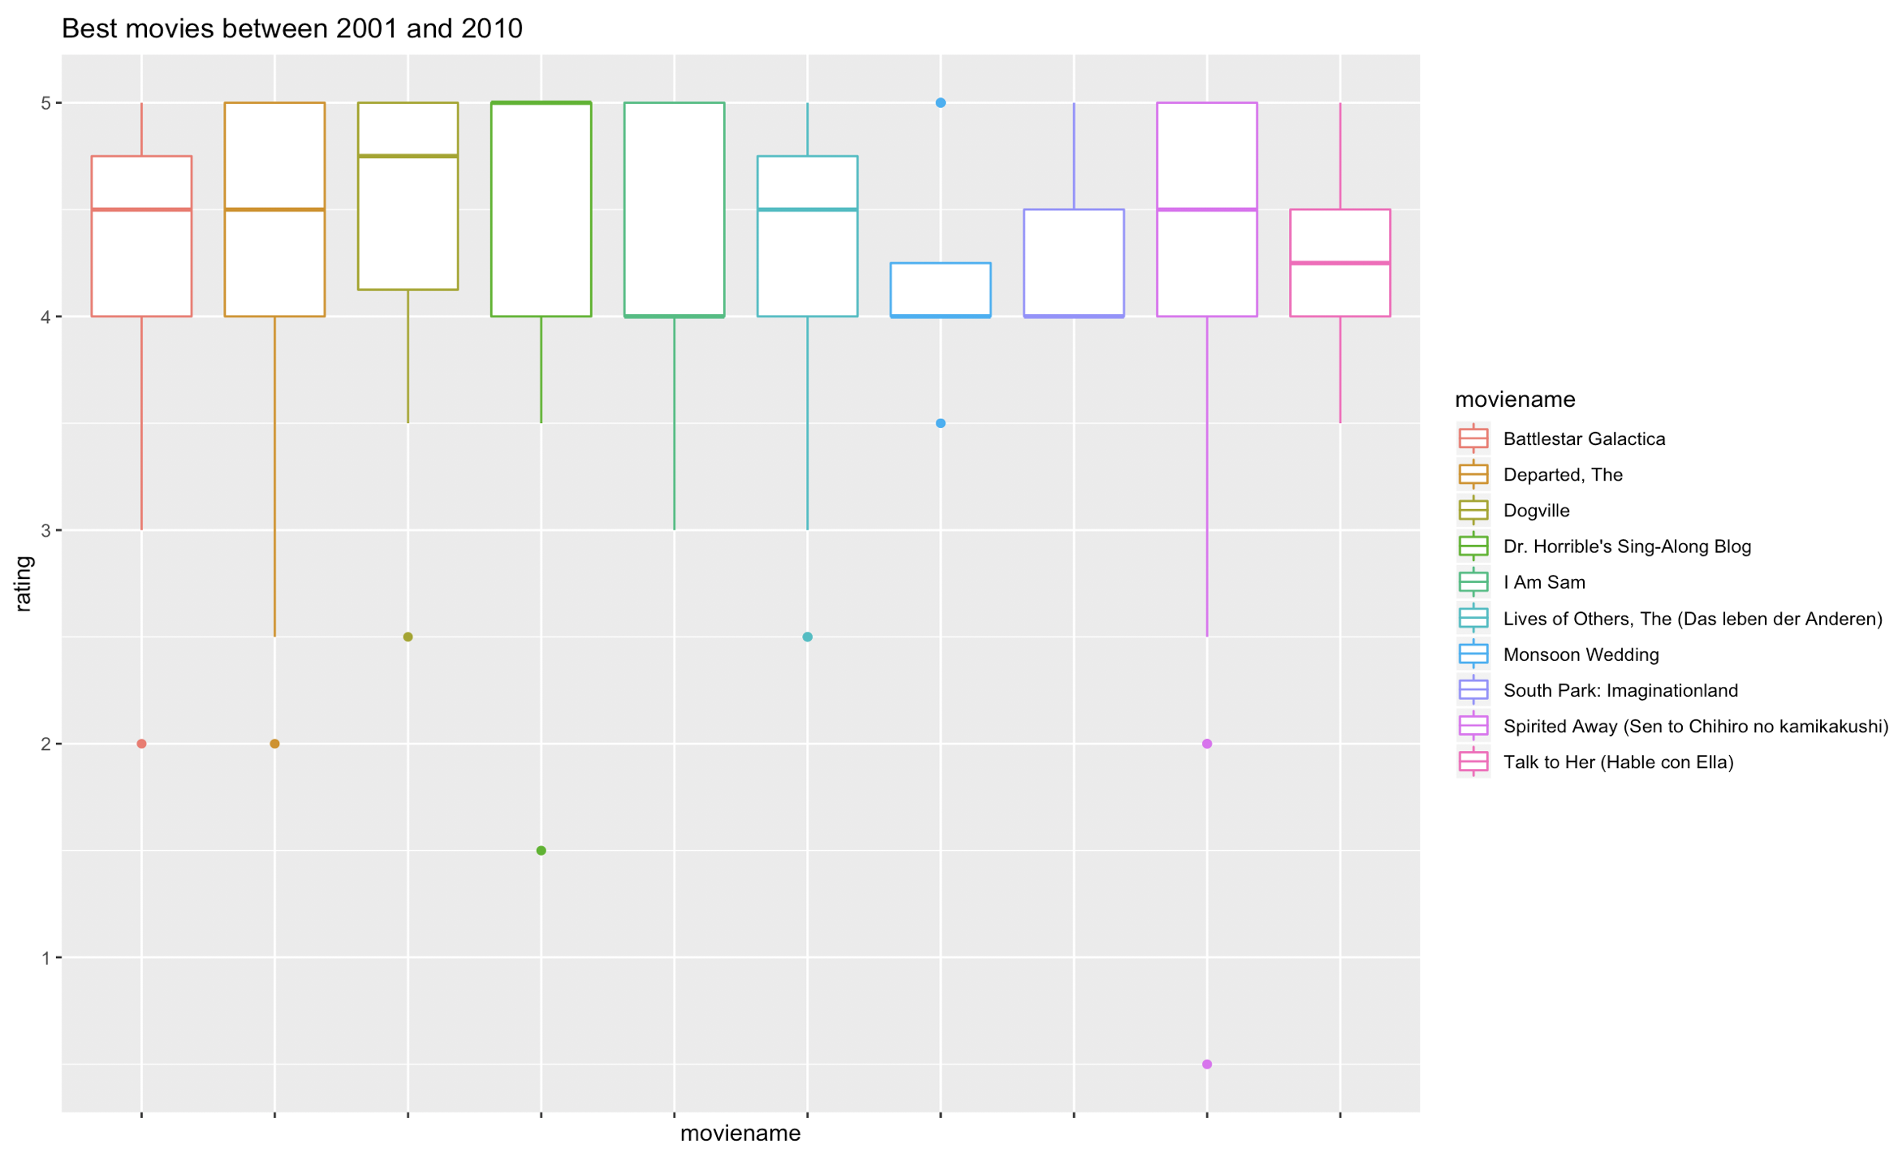
Visualization and processing
best movies in 2000s

Slide 14
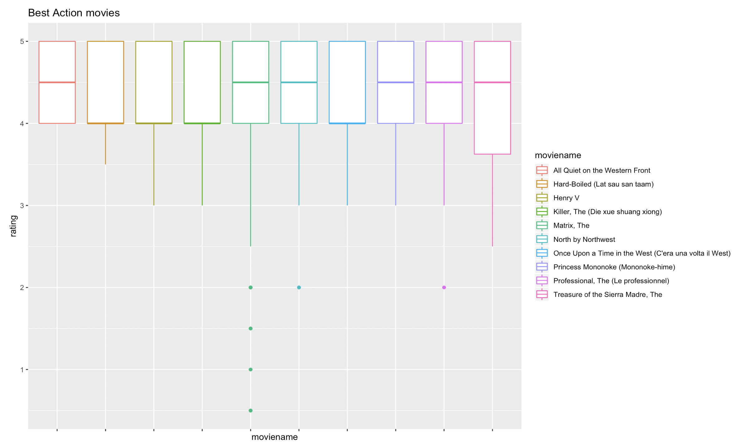
Visualization and processing
best action movies

Slide 15
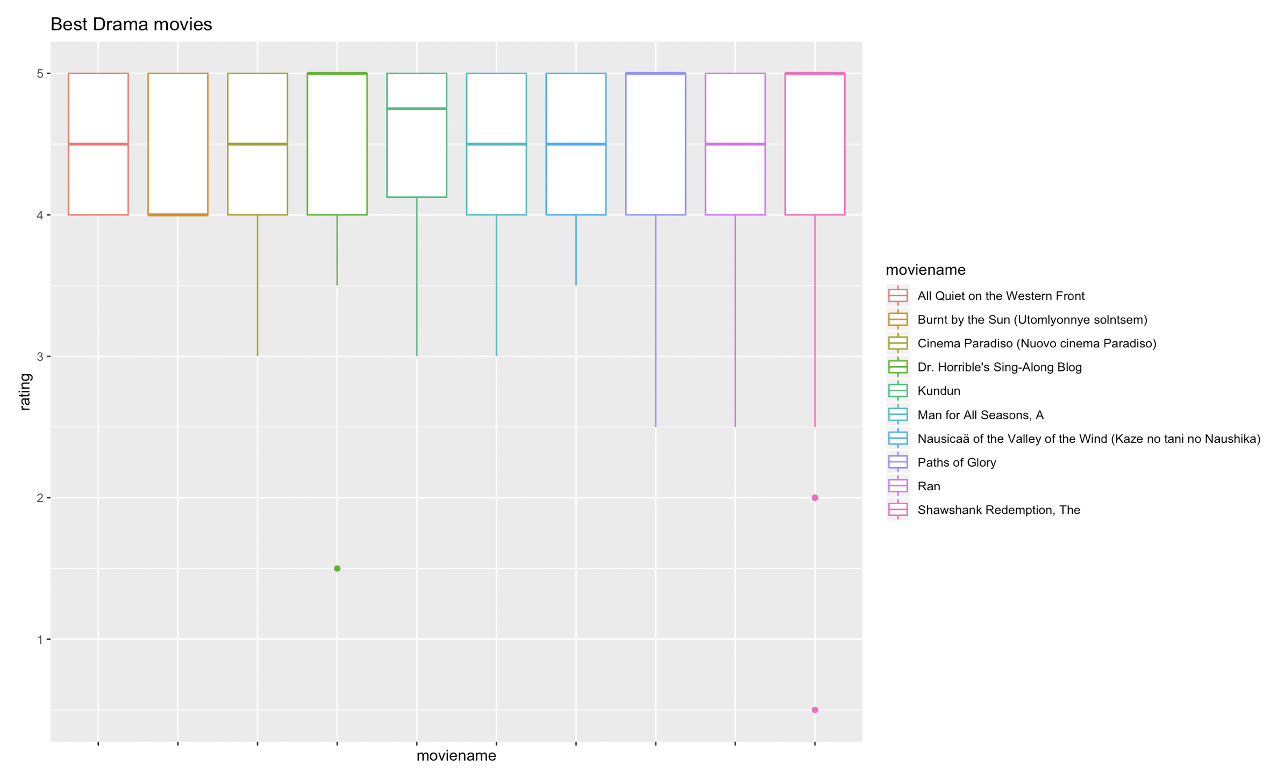
Visualization and processing
best drama movies

Slide 16
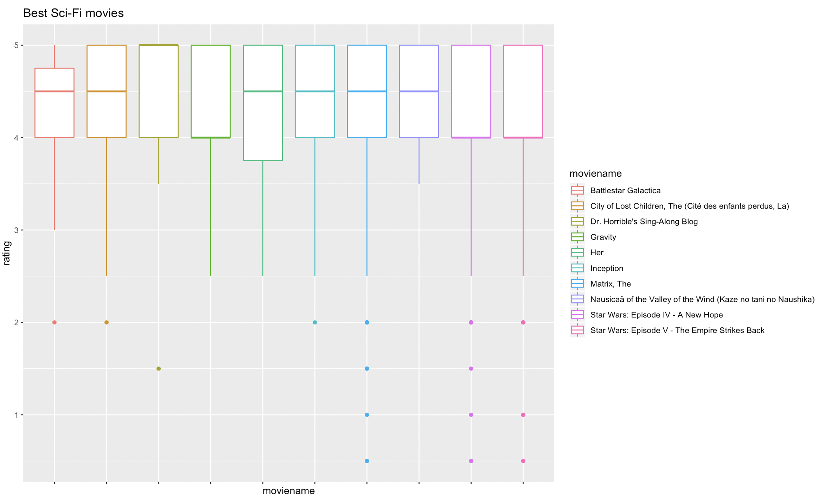
Visualization and processing
best Sci-Fi movies

Slide 17
Dimension reduction and variable selection
The dimension of our data is not large, so we don’t need to reduce the dimensions.
Predictors for users:
userId, ratings
Predictors for movies:
movieId, title, year, genres(18 dummies)
Concerns:
Here we have some concerns. Whether that a user rated a movie means s/he is interested in that movie? If s/he gave a score of 1 or 2 or if s/he hasn’t watched the movies, which shows s/he dislike it more?

Slide 18
Model exploration and selection
As we mentioned at first, we take unsupervised learning methods to deal with this problem.
Specifically, we divide our potential clients into 2 groups: new users and old users, who are differed by if they have recorded rating history in our data set. We take different models for different types of users.
New users: searching and sorting based on user’s input preferences
Old users: user-based collaborative filtering

Slide 19
Model exploration and selection
New users: searching and sorting based on user’s input preferences
Since we don’t have data of a totally new user, technically recommendation for a new user should not by a “data mining” approach.
To recommend for a new user, we let him/her input his/her preferred genre and time period. We search for all movies satisfied these requirement and sort them by average ratings. Then, we select top5 movies with highest average rating scores.

Slide 20
Model exploration and selection
Old users: user-based collaborative filtering
User-based collaborative filtering is simply explained as:
people watched these movies also watched…
The main point of this model is to find who are the similar users to a specific user (our client). Our idea is to redefine a detailed data frame and compute RMS of each predictor values for each pair of users. Who has the least RMS are our neighbors. Then we can assume they have similar tastes of movies as our clients, so we can recommend the movies they have watched but our clients have not yet.

Slide 21
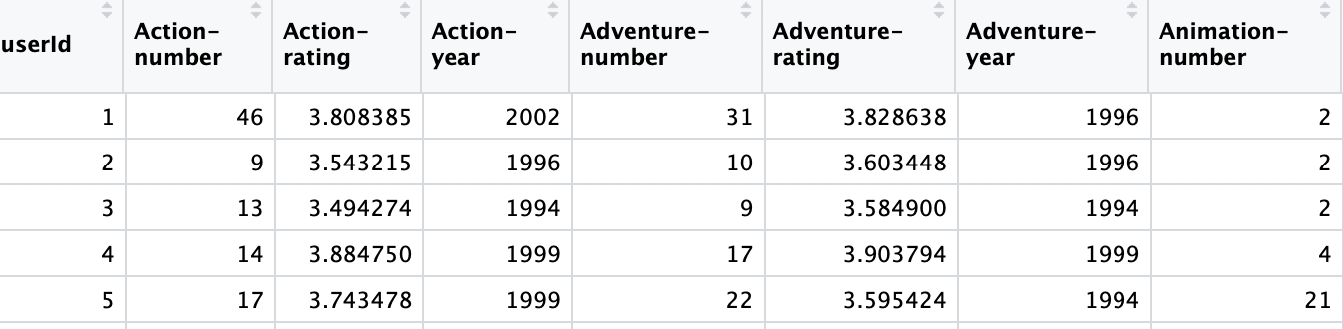
Model exploration and selection
Old users: user-based collaborative filtering
We rebuild a data frame to store the information of each user’s rating history. We have 55 variables in total, including user ID and number of rated movies, average rating score, mode of released years for each genre.

Slide 22
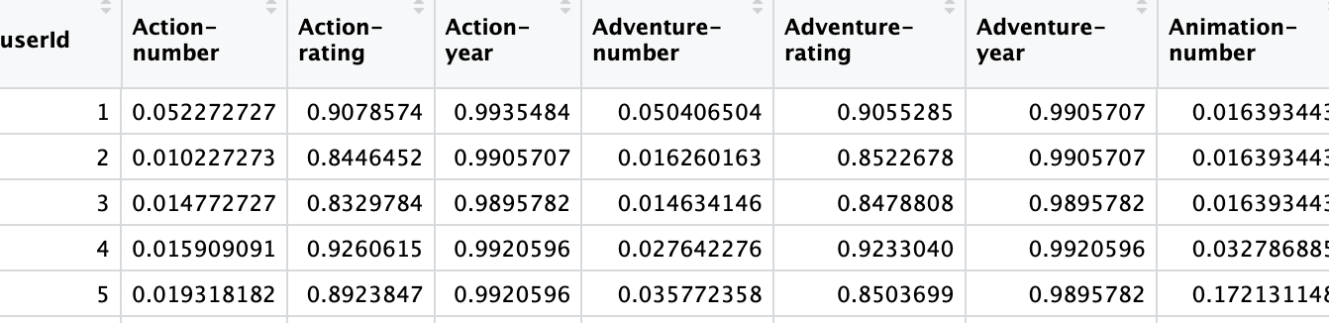
Model exploration and selection
Old users: user-based collaborative filtering
We normalize this data frame and take RMS to compute the distance between each pair of two users. The most similar (with least RMS – distance) users to a specific user (our client) are thought of the neighbors.
We only pick 3 nearest neighbors for following analysis.

Slide 23
Model exploration and selection
Old users: user-based collaborative filtering
Here we still have a problem: after find neighbors, how do we decide top5 movies among many candidate movies?
We want to take ratings as the measure. But here are 2 optional methods:
We take the average ratings(depends on number of neighbors who rated) of all candidate movies and pick the top5;
We take the (sum of ratings / 3) and pick the top5.
For example:
3 neighbors watched movie A and all gave 3
1 neighbor watched movie B and gave a 5
Which movie is better?
Each criteria has pros and cons. We just choose the first one.

Slide 24
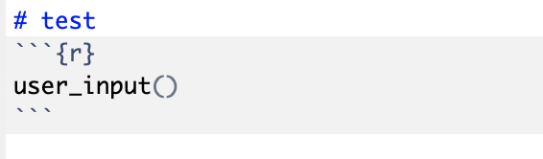
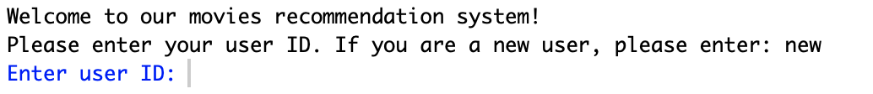
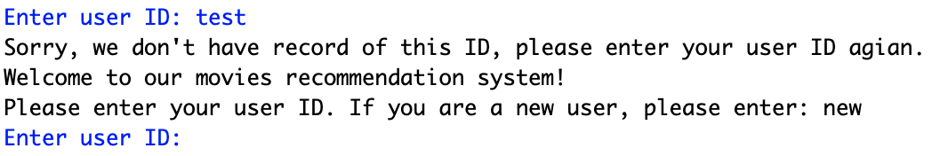
Model performance evaluation
We converge all models and algorithms into one function. And run the system automatically to give users recommendations.
Run this function
If user’s input is anything other than “new” or user ID recorded:

Slide 25
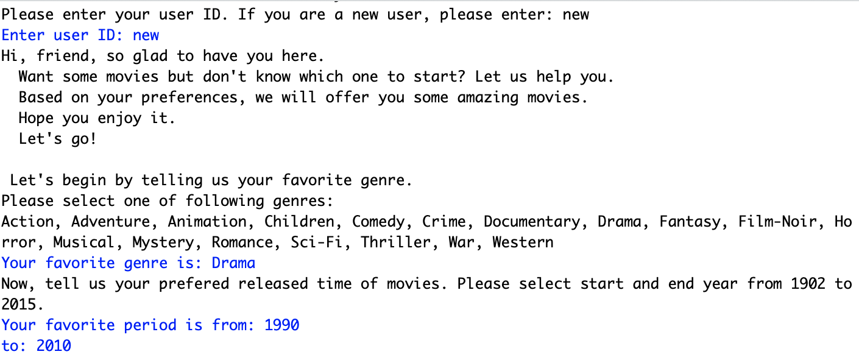
Model performance evaluation
For new users:

Slide 26
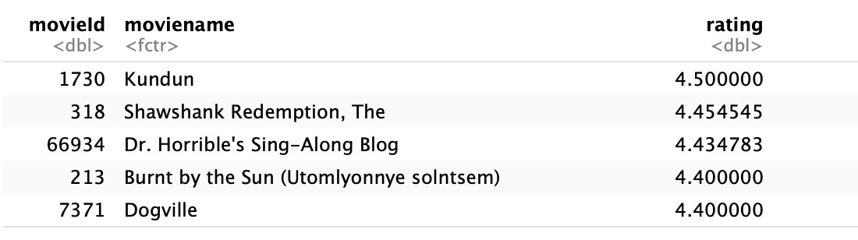
Model performance evaluation
For new users:
We get

Slide 27
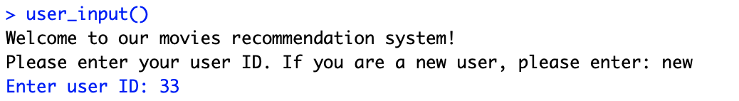
Model performance evaluation
For old users:

Slide 28
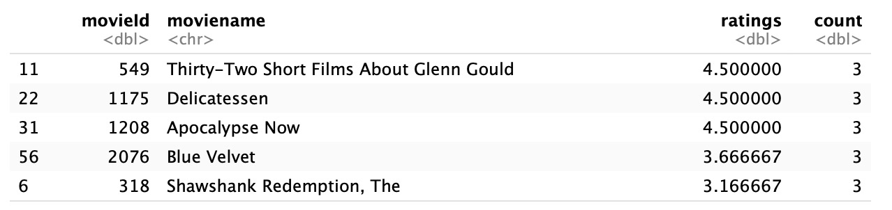
Model performance evaluation
For old users:
We get

Slide 29
Model performance evaluation Performance visualization
Because this is an unsupervised learning model, it’s hard to evaluate the performance.
Hopefully, we can test the model by do the experiment among volunteers and collect the data to check the performance and do a further improvement.

Slide 30
Future work
As just mentioned, we hope to test our system and check its performance. This can be achieved only by experiment.
Secondly, to define characteristics of a user or a movie, we need more predictors, like country, language, duration for a movie and age, gender, country, education level for a user.
And for time stamp, we didn’t consider about it this time. In the future work, we may need to use it as well.
Recommendation system is increasingly popular today. To do this project help us a lot to understand this practical and useful tool.

Slide 31
Thank you for listening
Q & A
Min Gong, Wei Chieh Wang

